Slide 1


Least Squares Support Vector Machine Models for Predicting Niger Delta PVT Properties
Location: University of Ghana, June 2020
Precious Onu
University of Uyo

Slide 2
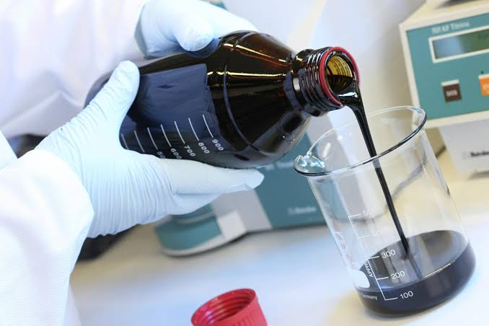


Introduction
Bubble point pressure, Solution gas oil ratio, and Viscosity are some of reservoir fluid properties (PVT properties) - Osman et al., 2001.
PVT properties are measured experimentally, which is time consuming.
PVT Correlations can predict these reservoir fluid properties

Slide 3




Review of Literature
Uwaga, O. A. (2008)
Bernie, A. (2012)
Ikiensikimama et al., (2006)
Ireke and Ikpeka (2017)
reported a case where oil recovery was underestimated by as much as 40%
(Oil technology, 2012)
Limited Dataset
reported incorrect PVT estimates in the Niger Delta
Technique

Slide 4





Research Methodology
Machine Learning techniques are being tested to develop PVT correlations (Sylvester, 2018; Adeeyo, 2016)
Identify
Determine
Better Models
Sensitive Parameters
Develop
Analyze
PVT Models
Developed Models
LSSVM

Slide 5
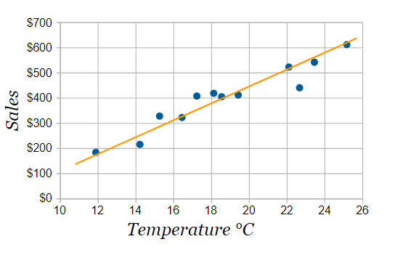
Least Square
“Line of best fit”

Slide 6
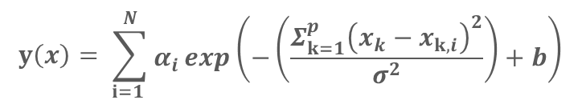
Least Square SVM
$$y\left(x\right)= \sum_{i=1 }^{N}{\begin{aligned}α_{i}\exp\left(−\left(\frac{Σ_{k=1}^{p}{\left(x_{k}−x_{k,i}\right)}^{2}}{σ^{2}}\right)+b\right) \\ \end{aligned}}$$
α
σ²
b
x
= Weight
= Kernel function bandwidth
= Bias
= Input
“Line of best fit”

Slide 7

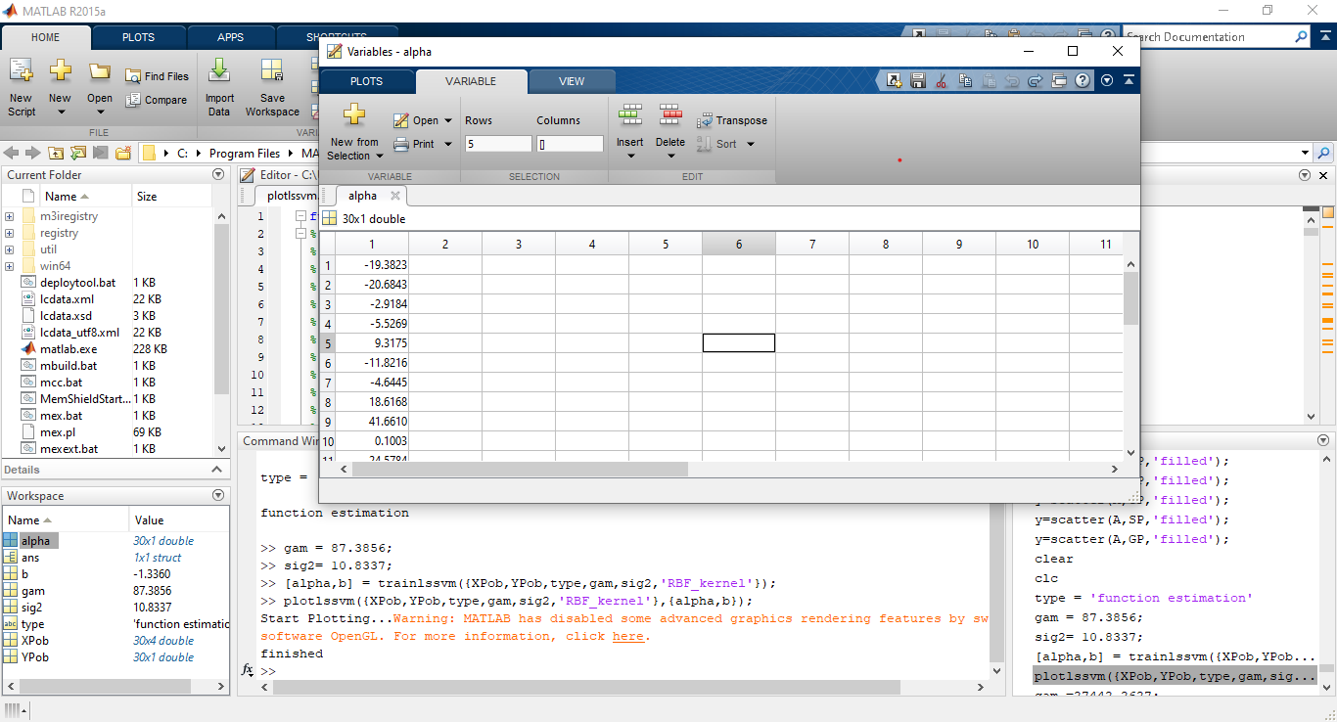
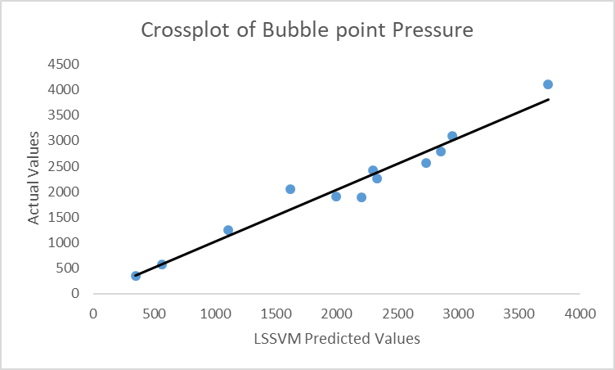
Bubble Point Pressure Plot

Slide 8


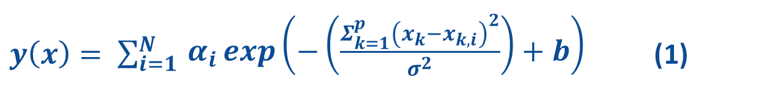
Bubble Point Pressure Correlation
$y\left(x\right)= \sum_{i=1 }^{N}{\begin{aligned}α_{i}\exp\left(−\left(\frac{Σ_{k=1}^{p}{\left(x_{k}−x_{k,i}\right)}^{2}}{σ^{2}}\right)+b\right) \\ \end{aligned}}$ (1)
Where α_{i} = -19.38229591, -20.68427318, -2.918430865, 5.526939615, 9.317458858, -11.8215614, -4.64445529, 18.61681913, 41.66102435, 0.100332208, -24.57840845, 9.918146516, 11.10977458, -7.735578627, -6.415116679, -4.104960024, 15.75313542, -8.084948584, 22.81743713 -4.953515696, 30.38922289, 2.061541595, -21.20179757, 2.107707483, - 27.99683585, 3.169566055, 0.302725069, 2.890265235, 0.824150514 -0.990189294
b = -1.33604,
σ²= 10.8337[exp (2.3827)] and x are the inputs.

Slide 9




Bubble Point Pressure Results
Author | Proposed Niger Delta Correlation | E_{r} | E_{a} | E_{max} | S | R | R²
Ikiensikimama et al., (2006). | Lasater (1958) | -0.761 | 0.761 | 4.25 | 768.1969 | 0.9 | 0.809
Ikiensikimama and Ogboja (2009) | Ikiensikimama and Ogboja (2009) | -4.321 | 4.321 | 13 | 1093.76 | 0.772 | 0.596
Adeeyo and Marhoun (2013) | Standing (1947) | 0.0873 | 0.204 | 0.38 | 1377.852 | 0.911 | 0.829
 | Vasquez and Beggs (1980) | -0.102 | 0.281 | 0.69 | 1743.508 | 0.906 | 0.820
Adeeyo (2018) | Adeeyo (2018) | 0.802 | 0.802 | 1.16 | 584.6698 | 0.942 | 0.887
The research work | Simplex LSSVM Model | -0.266 | 0.328 | 1.34 | 1011.583 | 0.909 | 0.826
Standing (1947)
Vasquez and Beggs (1980)
LSSVM Model (Simplex)

Slide 10
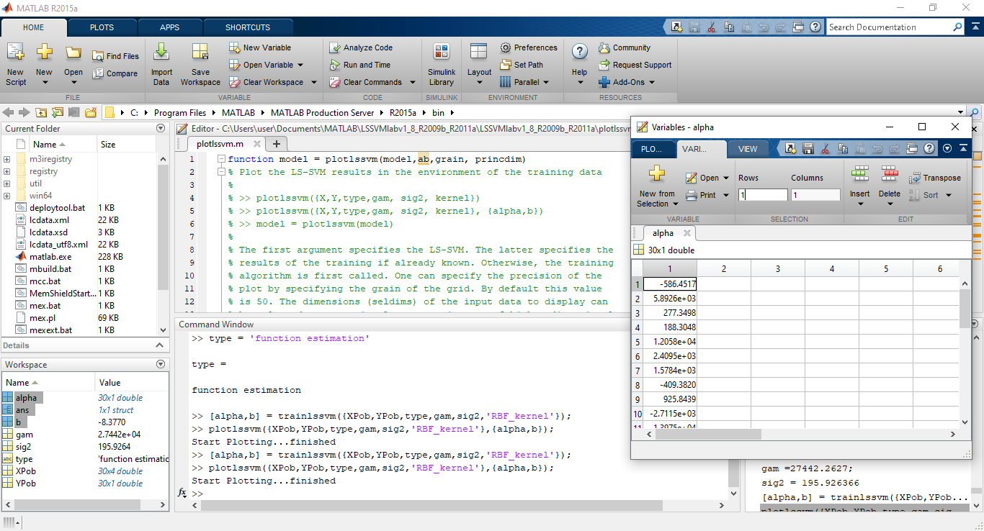
Oil Formation Volume Factor Plot

Slide 11

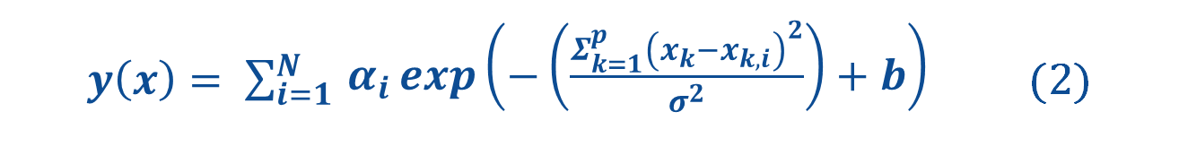
Oil Formation Volume Factor Correlation
$y\left(x\right)= \sum_{i=1 }^{N}{\begin{aligned}α_{i}\exp\left(−\left(\frac{Σ_{k=1}^{p}{\left(x_{k}−x_{k,i}\right)}^{2}}{σ^{2}}\right)+b\right) \\ \end{aligned}}$ (2)
Where α_{i} = 647.0098424, 14032.9571, 2930.875691, -334.6876715, 34097.84566, 6884.787052, -985.433888, -2330.218432, 2257.968027, -3202.486028, -39120.93499, -1268.668514, 4670.319123, -4236.558858, -1900.901868, 5622.322632, 2474.855033, -21466.44305, -2343.20163, -311.0206132, -2051.292509, -1792.699565, -1876.384504, -1268.249496, 6756.117366, 11055.28591, -1097.313431, -11987.71992 5175.914749, 967.956788
b = 0.505812153, σ2= 856.38967[exp (6.752)]
and (x,x_{i}) are inputs.

Slide 12
Oil Formation Volume Factor Results
Author | Proposed Niger Delta Correlation | E_{r} | E_{a} | E_{max} | S | R | R²
Ikiensikimama et al., (2006). | Alshammasi (1999) | -0.087 | 0.105 | 0.98 | 0.2743 | 0.2611 | 0.068
Adeeyo and Marhoun (2013) | Vasquez and Beggs (1980) | -0.073 | 0.103 | 0.94 | 0.2621 | 0.2638 | 0.07
 | Kartoatmodjo and Schmidt (1991) | -0.085 | 0.105 | 0.98 | 0.2723 | 0.2441 | 0.06
Ireke and Ikpeka (2017) | Al-Marhoun (1988) | -0.15 | 0.196 | 0.4 | 0.0471 | -0.058 | 0.034
 | Ireke and Ikpeka (2017) | -0.098 | 0.116 | 1.03 | 0.282 | 0.233 | 0.054
Sylvester (2018) | Sylvester (2018) | -0.101 | 0.114 | 0.96 | 0.2581 | 0.2594 | 0.067
The research work | Simplex LSSVM Model | -0.076 | 0.125 | 1.11 | 0.3225 | 0.2025 | 0.041
Vasquez and Beggs (1980)
Kartoatmodjo and Schmidt (1991)
Al-Shammasi (1999)

Slide 13
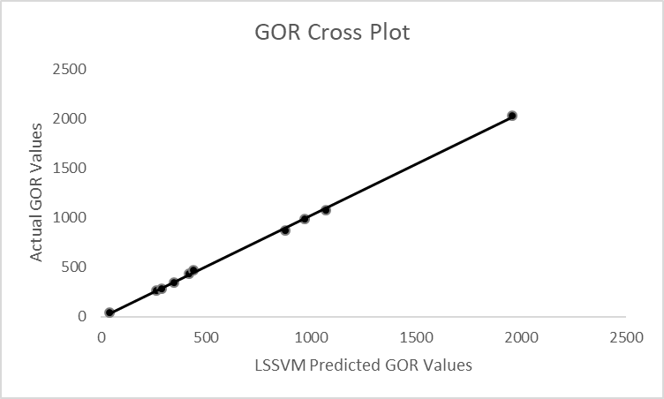
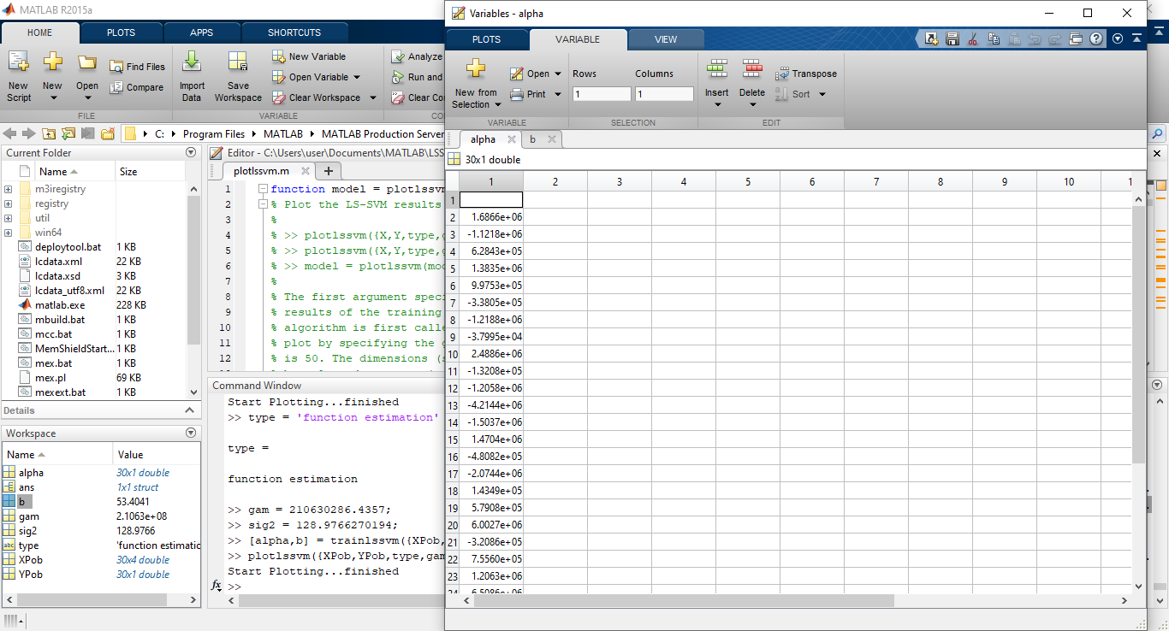
Gas Oil Ratio Plot

Slide 14
Gas Oil Ratio Results
Authors | Niger Delta proposed correlation | E_{r} | E_{a} | E_{max} | S | R | R²
Ikiensikimama et al., (2006) | Farshad et al. (1992) | -0.309 | 0.513 | 2.397 | 306.523 | 0.9383 | 0.8804
Adeeyo and Al-Marhoun (2013) | Glaso (1980) | -0.055 | 0.312 | 0.647 | 319.835 | 0.9458 | 0.8945
 | Vasquez and Beggs (API<=30) | 0.23 | 0.29 | 0.471 | 297.645 | 0.935 | 0.8743
 | Kartoatmodjo and Schmidt (1991) | 0.1761 | 0.509 | 0.792 | 167.409 | 0.7407 | 0.5486
Sylvester (2018) | Sylvester (2018) | -0.244 | 0.38 | 0.975 | 546.075 | 0.9326 | 0.8702
The research work | Grid search LSSVM Model | -0.122 | 0.253 | 0.482 | 330.23 | 0.9661 | 0.9334
LSSVM Model (Grid Search)
Glaso (1980)
Vasquez and Beggs (1980)

Slide 15
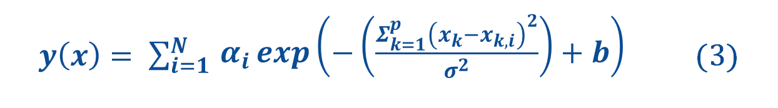
Gas Oil Ratio Correlation
$y\left(x\right)= \sum_{i=1 }^{N}{\begin{aligned}α_{i}\exp\left(−\left(\frac{Σ_{k=1}^{p}{\left(x_{k}−x_{k,i}\right)}^{2}}{σ^{2}}\right)+b\right) \\ \end{aligned}}$ (3)
Where α_{i} = -1387427.205 1686635.399 -1121805.603, 628430.1667, 1383491.56, 997532.5657 -338050.3527, -1218761.908, -37994.90931, 2488649.037, -132079.0424, -1205809.289, -4214389.958, -1503732.182, 1470443.797, -480821.5401, -2074409.409, 143494.8816, 579080.4443, 6002656.792, -320861.8269, 755598.9399, 1206303.899, 6508628.23, - 766825.4194, -285165.7816, -28437.73838, 1088519.627, - 10999547.65, 1176654.476
b = 53.40409228,
σ²= 128.9766 [exp (4.8596)] and (x,x_{i}) are the inputs.

Slide 16

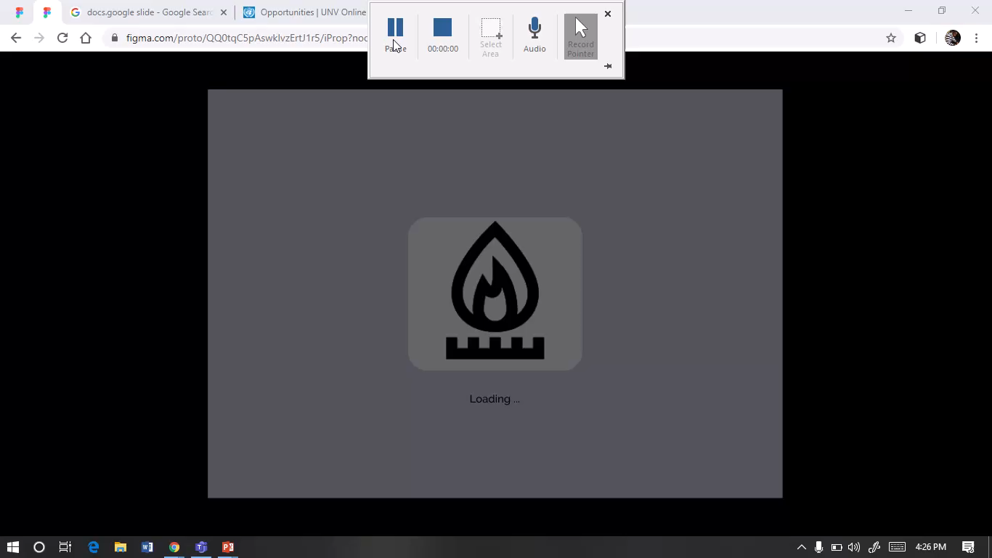

i’PVTm Software Demo

Slide 17


Significance
$200,000
1/7 time reduction

Slide 18



Conclusion
PVT properties are measured primarily in the laboratory
Developed a more precise correlation and software
Initiate cost and time savings
(SPE -167560, Imo-jack and Emelle, 2013)
1/7 Time reduction
$20,000/reservoir

Slide 19

Recommendation
Adopt a more precise Machine Learning based Software (i’PVTm)
Software performance increases as rate of deployment increase

Slide 20
References
Adeeyo, Y. A. (2018). Bubble point Pressure Mathematical Modelling for Nigeria Crude Oil. Paper presented at the Nigeria Annual International Conference and Exhibition, Lagos, Nigeria. 6-8 August, 2018.
Al-Shammasi, A. A. (2001). A Review of Bubble point Pressure and Oil Formation Volume Factor Correlations. Society of Petroleum Engineers Reservoir Evaluation and Engineering, Vol. 4, No. 2, pp. 146-160.
Glaso, O. (1980). Generalized Pressure-Volume Temperature Correlations. Journal of Petroleum Technology. Vol. 32, No. 5, pp. 785-795.
Ikiensikimama, S. S., Madu, J., and Dipeolu, L. (2006). Black Oil Empirical PVT Correlations Screening for the Niger Delta Crude. Paper presented at the 30th Annual Society of Petroleum Engineers International Technical Conference and Exhibition, Abuja, Nigeria. 31 July–2 August, 2006.
Ikiensikimama S. S. and Ogboja, O. (2008). Review of PVT Correlations for Crude Oils. Global Journal of Pure and Applied Sciences, Vol. 14, No. 3, pp. 331-337.
Ikiensikimama, S. S., and Ogboja, O. (2009). New Bubble point Pressure Empirical Correlation. Paper presented at the 33rd Annual Society of Petroleum Engineers International Technical Conference and Exhibition, Abuja, Nigeria. 3-5 August, 2009.
Imo-Jack, O., and Emelle, C. (2013). An Analytical Approach to Consistency Checks of Experimental PVT Data. Paper presented at the Nigeria Annual International Conference and Exhibition, Lagos, Nigeria. 30 July – 1 August.
Ireke, I. U., and Ikpeka, P. M. (2017). Impact of PVT Correlations on Reserve Estimation: Reliability and Qualitative Analysis. Paper presented at the Nigeria Annual International Conference and Exhibition, Lagos, Nigeria. 31 July–2 August 2017.
Uwaga, O. A. (2008). Developing Marginal Fields in the Niger Delta: Recovery and Economics Can Be Better than Currently Estimated. Paper presented at the 32nd Annual Society of Petroleum Engineers International Technical Conference and Exhibition in Abuja, Nigeria. 4-6 August, 2008

Slide 21

THANK YOU!
This Photo by Unknown Author is licensed under CC BY

Slide 22
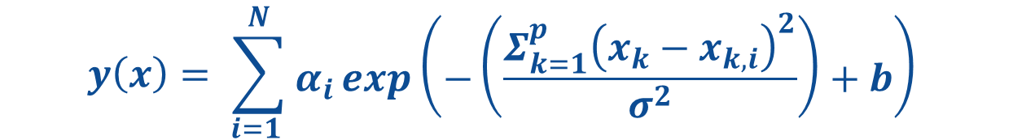
LSSVM Optimization
$$y\left(x\right)= \sum_{i=1 }^{N}{\begin{aligned}α_{i}\exp\left(−\left(\frac{Σ_{k=1}^{p}{\left(x_{k}−x_{k,i}\right)}^{2}}{σ^{2}}\right)+b\right) \\ \end{aligned}}$$
Reservoir fluid properties | Optimization algorithm | ϒ |  | σ²
Bubble point pressure (P_{ob}), psia | Simplex | 87.3856 | e^{4.47} | 10.8337 | e^{2.3827}
Oil formation volume factor (B_{ob}), bbl/STB | Simplex | 67073.6905 | e^{11.114} | 856.38967 | e^{6.752}
Solution gas oil ratio (R_{so}), SCF/STB | Grid Search | 210630286.4357 | e^{19.166} | 128.9766 | e^{4.8596}

Slide 23
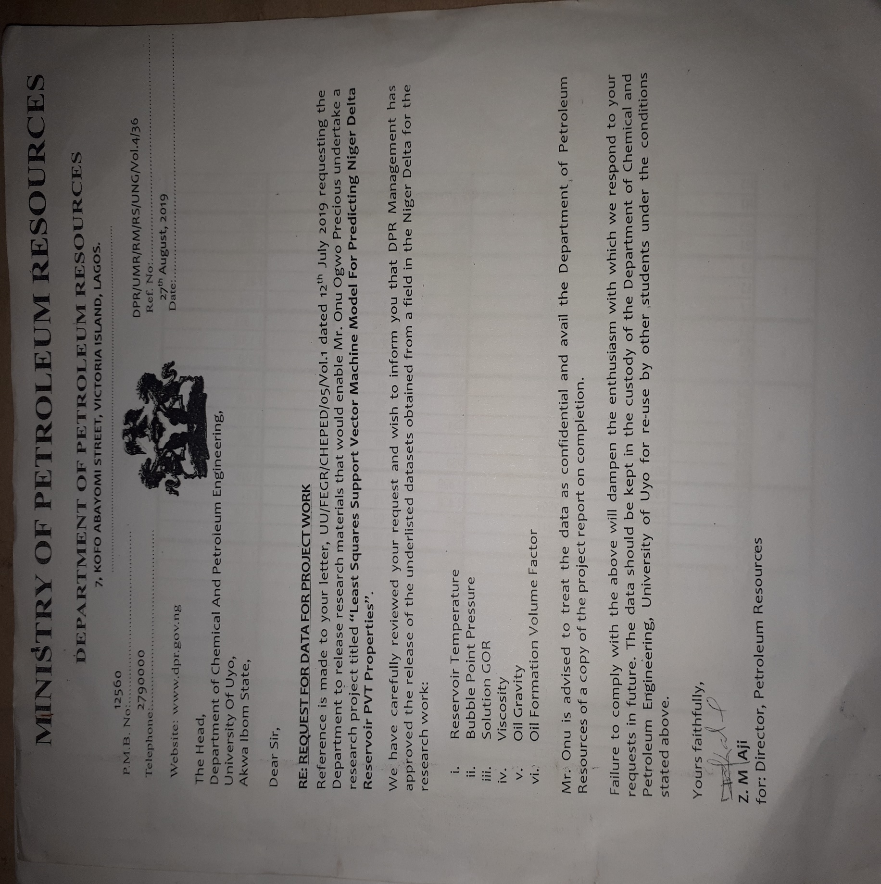
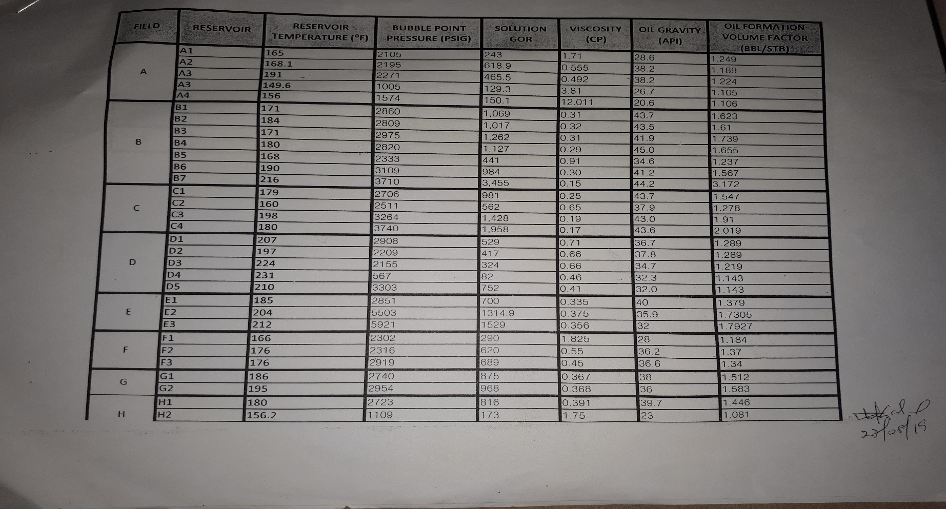
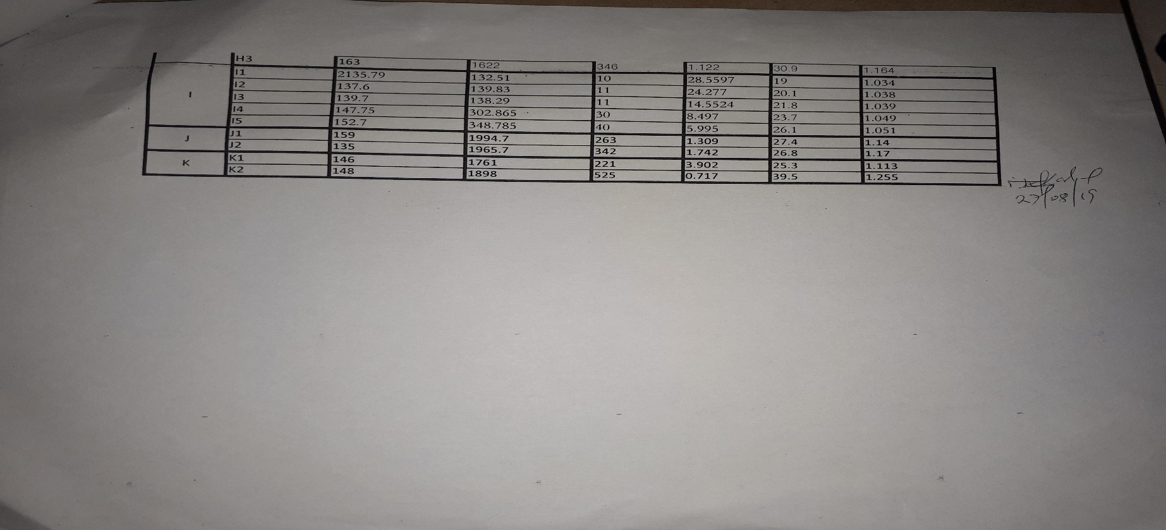
DPR Dataset

Slide 24
Models Results
Statistical Results comparison file
Statistical comparison of models.xlsx
PVT Results from other models
Results from Other models.xlsx
DPR Dataset
DpR.xlsx

